Slide 1
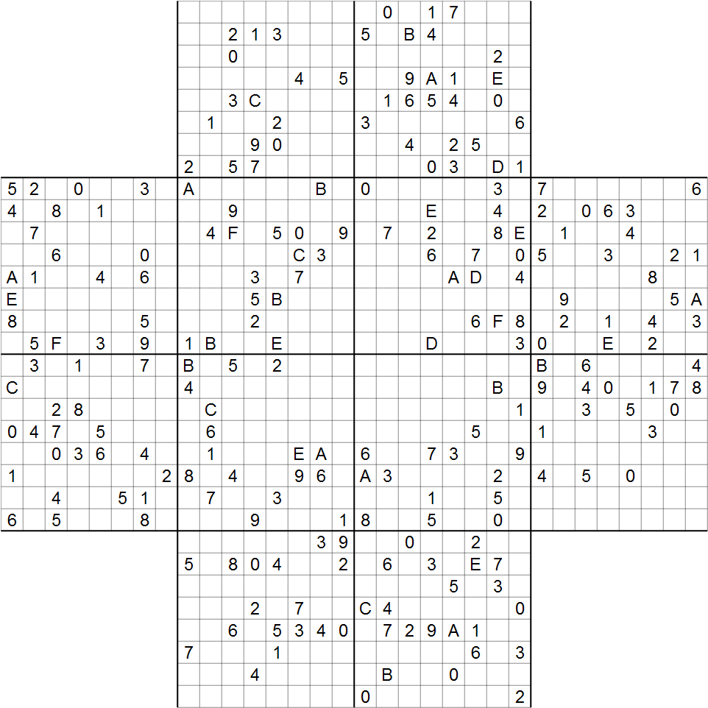
Doku
David Grayson
Las Vegas
Ruby Meetup
2012-4-18
Hexamurai
from Elektor
July 2011

Slide 2
Doku is a Ruby gem for solving Sudoku-like puzzles

Slide 3
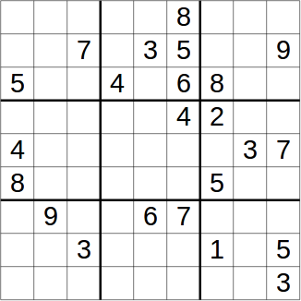
Sudoku

Slide 4
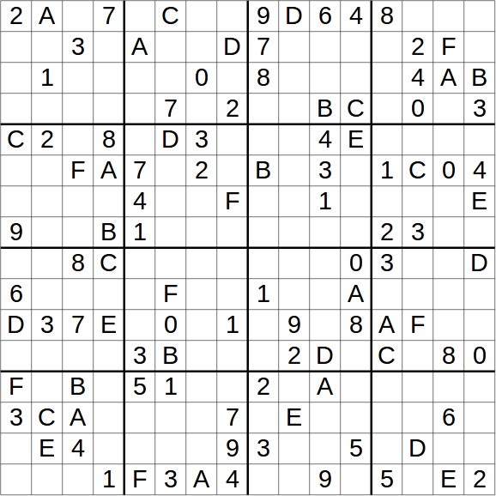
Hexadoku
Hexamurai
from Elektor
Oct 2011

Slide 5
Hexamurai
Hexamurai
from Elektor
July 2011

Slide 6
Demo

Slide 7
About Doku
Written purely in Ruby
Complete documentation
Test-driven development
Lots of time refactoring
Short methods
Plus, it can generate SVGs!

Slide 8
Simplified Class Structure
Sudoku
Hexadoku
Hexamurai
Puzzle

Slide 9
Puzzle class
Every subclass defines:
  glyphs (e.g. 1,2,3,4,5,6,7,8,9)
  squares (every spot on the puzzle)
  groups (sets of squares)
Every instance has:
  glyph_state: Hash associating squares to glyphs.
Squares and glyphs can be any ruby object.

Slide 10
Puzzle Solution
Solution is a set of glyph assignments
  e.g. write 6 in the square at (3,4)
Solution achieves certain goals exactly once:
  For each square, assign ONE glyph to it.
  Assign every glyph to every group ONCE.
Each glyph assignment achieve a subset of these goals.

Slide 11
Sudoku-like puzzles can be reduced to exact cover problems!

Slide 12
Exact cover problem
Given: universe set
Given: several of subsets of the universe
Problem: Choose some of those subsets so that every element in the universe set appears exactly once.

Slide 13
Exact cover example
Universe: [A,B,C,D,E,F,G]
Subsets: [C,E,F]
[A,D,G]
[B,C,F]
[A,D]
[B,G]
[D,E,G]

Slide 14
Exact cover example
Universe: [A,B,C,D,E,F,G]
Subsets: [ C, E,F ]
[A, D, G]
[ B,C, F ]
[A, D ]
[ B, G]
[ D,E, G]
Solution: [ B, G]
[A, D ]
[ C, E,F ]

Slide 15
Algorithm X
A B C D E F G
p 0 0 1 0 1 1 0
q 1 0 0 1 0 0 1
r 0 1 1 0 0 1 0
s 1 0 0 1 0 0 0
t 0 1 0 0 0 0 1
u 0 0 0 1 1 0 1
[ C, E,F ]
[A, D, G]
[ B,C, F ]
[A, D ]
[ B, G]
[ D,E, G]
Subsets
Matrix with column and row labels

Slide 16
Algorithm X Demo
A B C D E F G
p 0 0 1 0 1 1 0
q 1 0 0 1 0 0 1
r 0 1 1 0 0 1 0
s 1 0 0 1 0 0 0
t 0 1 0 0 0 0 1
u 0 0 0 1 1 0 1
B C E F
p 0 1 1 1
r 1 1 0 1
E

Slide 17
Algorithm X Demo
A B C D E F G
p 0 0 1 0 1 1 0
q 1 0 0 1 0 0 1
r 0 1 1 0 0 1 0
s 1 0 0 1 0 0 0
t 0 1 0 0 0 0 1
u 0 0 0 1 1 0 1
B C E F
p 0 1 1 1
r 1 1 0 1

Slide 18
Algorithm X Demo
A B C D E F G
p 0 0 1 0 1 1 0
q 1 0 0 1 0 0 1
r 0 1 1 0 0 1 0
s 1 0 0 1 0 0 0
t 0 1 0 0 0 0 1
u 0 0 0 1 1 0 1
B C E F G
p 0 1 1 1 0
r 1 1 0 1 0
t 1 0 0 0 1
C E F
p 1 1 1
Empty matrix = success!

Slide 19
Efficient Algorithm X
Need good data type for a large matrix
Finding 1s in a given column or row quickly
Removing columns and rows quickly
Quick reinserting

Slide 20
Dancing Links Intro
class Node
attr_accessor :left, :right
end

Slide 21
Easy removal
class Node
attr_accessor :left, :right
def remove
left.right = right
right.left = left
end
end

Slide 22
Also easy reinsertion!
class Node
attr_accessor :left, :right
def remove
left.right = right
right.left = left
end
def reinsert
left.right = right.left = self
end
end
No arguments
For reinsert!

Slide 23
2D doubly-linked list

Slide 24
2D doubly-linked list
Root
node
Column
headers
A
B
C
D
E
F
G
Ruby's default
#inspect can
NOT handle
this!

Slide 25
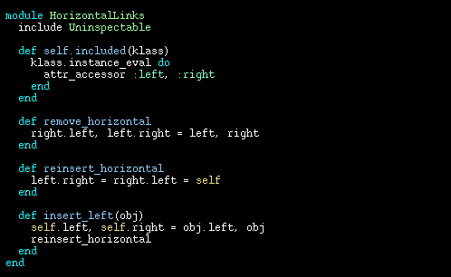
HorizontalLinks module

Slide 26
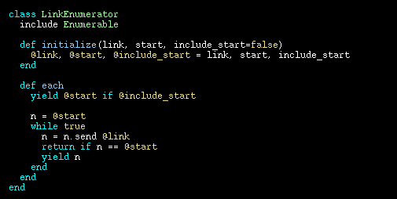
LinkEnumerator class

Slide 27
Hexamurai
768 squares
2872 goals
3433 subsets
13 minutes
to find ALL
solutions!
768 squares
2872 goals
3433 subsets
13 minutes to find ALL solutions

Slide 28
Architecture
Sudoku
Hexadoku
Hexamurai
Puzzle
PuzzleOnGrid
DancingLinks
SolvableWithDancingLinks
LinkMatrix
HorizontalLinks
Column
VerticalLinks
Node
LinkEnumerator

Slide 29
The end

Slide 30
Hidden slide

